Slide 1
Introducing Knockout
Jon Galloway | Technical Evangelist
Christopher Harrison | Content Developer

Slide 2

Meet Christopher Harrison | ‏@geektrainer
Content Developer
Focused on ASP.NET and Office 365 development
Microsoft Certified Trainer
Still misses his Commodore 64
Long time geek
Regular presenter at TechEd
Periodic blogger
Certification advocate
Marathoner, husband, father of one four legged child

Slide 3

Meet Jon Galloway | @jongalloway
Azure Technical Evangelist
Focused on ASP.NET MVC
http://weblogs.asp.net/jongalloway
Web development on Microsoft platform since late '90s
Ex-submariner; Showcase Showdown winner “Price is Right”
Popular Author and Conference Speaker
Wrox Professional MVC 5; MVC Music Store tutorial
Virtual ASP.NET MVC Conference (mvcConf)
World wide Web Camps speaker
Herding Code podcast (http://herdingcode.com)

Slide 4
Course Topics
Creating Dynamic Webpages With Knockout
01 | Introducing Knockout | 04 | Making Server Calls and Persisting Data
02 | Binding and Models | 05 | Bringing It All Together
03 | Loops, Logic and Templates

Slide 5
Setting Expectations
Target Audience
HTML/CSS developer
New to Knockout
Possibly XAML developer wanting to move to web
Looking to fill knowledge gaps
Suggested Prerequisites/Supporting Material
Visual Studio 2015 Community

Slide 6
Join the MVA Community!
Microsoft Virtual Academy
Free online learning tailored for IT Pros and Developers
Over 2M registered users
Up-to-date, relevant training on variety of Microsoft products
“Earn while you learn!”
Get 50 MVA Points for this event!
Visit http://aka.ms/MVA-Voucher
Enter this code: [???] (expires 27 Oct 14)

Slide 7
Introducing Knockout
Jon Galloway | Technical Evangelist
Christopher Harrison | Content Developer

Slide 8
Introducing Knockout
What is Knockout?
Obtaining Knockout
Hello, Knockout

Slide 9
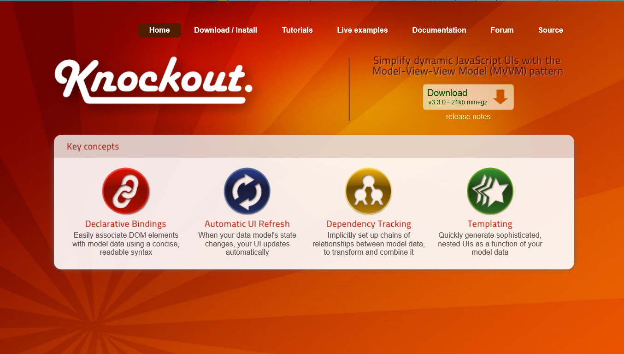
What is Knockout?
A JavaScript Library (not framework)
Made to simplify dynamic JavaScript Uis with the Model-View-ViewModel Patern
Key concepts
Declarative Bindings
Automatic UI Refresh
Dependency Tracking
Templating

Slide 10
What we’ll be building

Slide 11
What is Knockout?

Slide 12
What Knockout provides
An MVVM library
Automatic UI refresh and updates
Reusable templates
Can be used with nearly any framework
Focused on data binding
Small library size

Slide 13
What Knockout isn’t
A full framework
Knockout doesn’t compete with jQuery
Still use jQuery for Ajax calls and effects

Slide 14
What is MVVM?
Model
Domain model (or data access layer)
View
The display the user will see
View model
The data the user will see

Slide 15
MVVM in pictures
Model
FirstName
View
View Model
LastName
Name
Name
Email
Email
Email
LoadUser()
SaveUser()

Slide 16
Obtaining Knockout

Slide 17
Getting Knockout with NuGet

Slide 18
Getting Knockout with Bower

Slide 19
Using Knockout from CDN

Slide 20
Hello, Knockout

Slide 21
Knockout concepts
Observables
Things we want to keep an eye on
Values may change
When they do, everyone that’s interested is alerted
Arrays
Collections of objects
Can also be observable
Computed observables
Values that are the result of code execution

Slide 22
Hello, Knockout

